Slide 1
Youth sports registration portal
NAGARAJ
HANAMANTRAY
SHIVARAJ
MAHANTESH
KARTHIK

Slide 2
PROJECT DOMAIN :
Domain Description* The youth sports registration portal operates within the domain of sports management, specifically focusing on youth sports leagues and programs. The portal aims to streamline the registration process for parents/guardians, coaches, and administrators, providing a centralized platform for managing registrations, payments, and team assignments. The domain encompasses various sports, age groups, and program types (e.g., recreational, competitive, camps), catering to diverse youth sports organizations, schools, and community centers. *Key Domain Components* Key components of the youth sports registration portal domain include: - *Registration Management*: participant registration, payment processing, and document upload (e.g., medical forms, waivers) - *Team Management*: roster creation, coach assignments, and team scheduling - *Payment Processing*: secure payment gateway integration for registration fees and donations - *Communication*: email notifications, reminders, and alerts for registrations, payments, and program updates - *Reporting and Analytics*: participant demographics, registration statistics, and revenue tracking - *Security and Compliance*: data protection, privacy policies, and adherence to youth sports regulations - *User Management*: role-based access control for administrators, coaches, parents, and participants - *Integration*: compatibility with existing sports management software and systems.

Slide 3
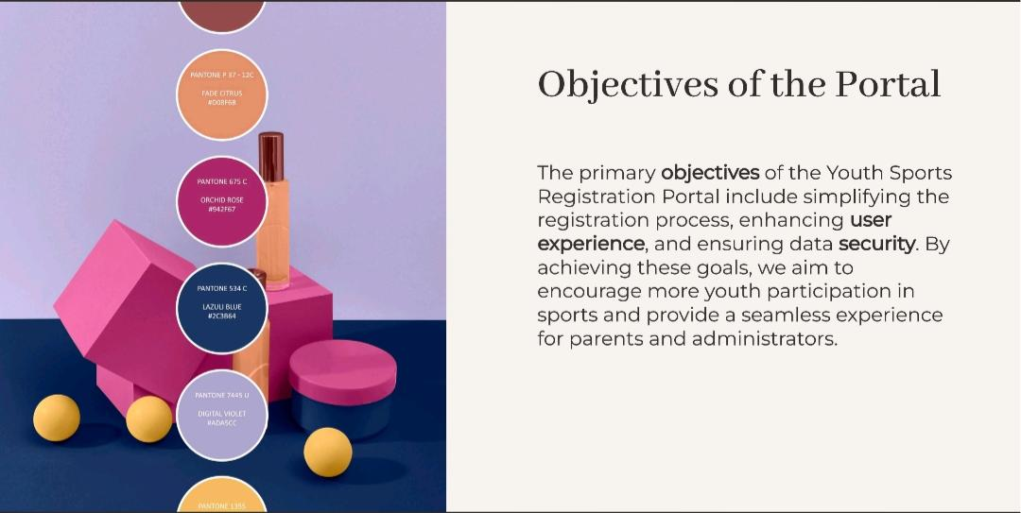
OBJECTIVES :

Slide 4
ALGORITHM :
1. User (parent/guardian) accesses registration portal. 2. User selects sport, program, and age group. 3. System checks availability and eligibility criteria. 4. User fills out registration form (participant info, contact details, etc.). 5. System processes payment (if applicable) via integrated payment gateway. 6. System validates registration data and checks for duplicates. 7. Upon successful registration, system sends confirmation email and updates database. 8. Administrator reviews and approves registration (optional).

Slide 5
WORKFLOW :
*Start* 1. *User Access*→ User visits registration portal website 2. *Login/Register*→ User logs in (if existing) or creates new account 3. *Select Program*→ User selects sport, program, and age group→ System checks availability and eligibility criteria
4. *Registration Form*→ User fills out registration form (participant info, contact details, etc.)
5. *Payment Processing* (if applicable)→ System processes payment via integrated payment gateway→ Payment success/failure notification
6. *Review & Submit*→ User reviews registration details→ User submits registration 7. *System Validation*→ System validates registration data→ Duplicate registration check→ Eligibility criteria check 8. *Confirmation*→ System sends confirmation email to user→ Updates database with new registration 9. *Admin Review* (optional)→ Administrator reviews and approves registration 10. Registration Completed

Slide 6
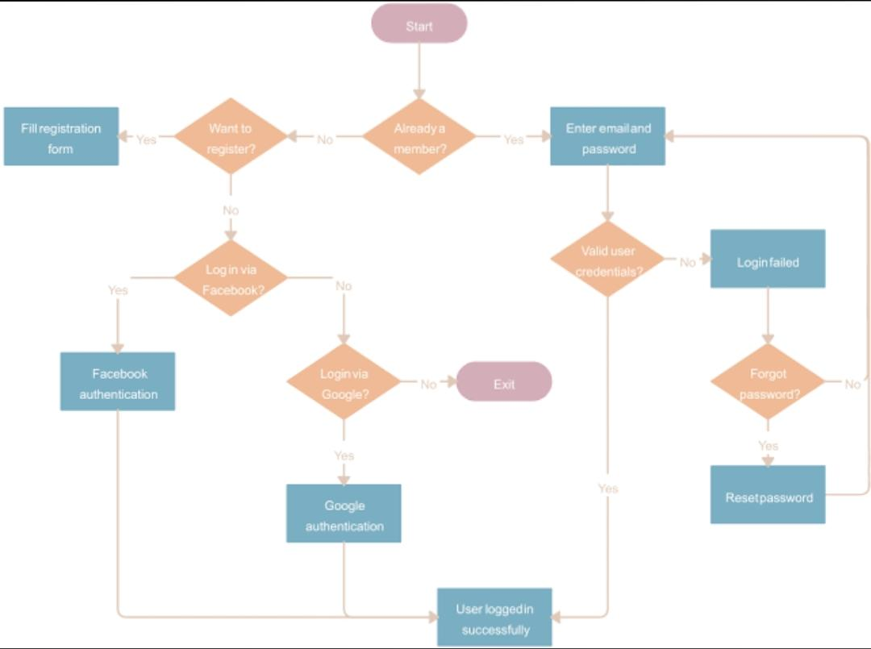
DIAGRAM :

Slide 7
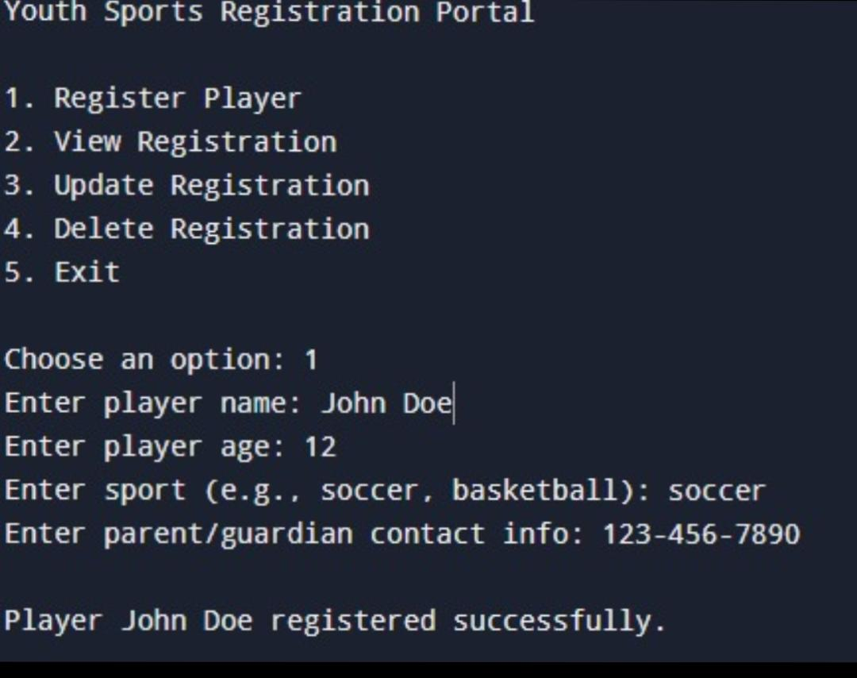
OUTPUT:

Slide 8
THANK YOU......

